Slide 1
Units 15 Chapter 24
MEASURING THE COST OF LIVING
Price levels have gone up over a period of time
Need for an index to measure the change in prices and the effects on consumers
Inflation

Slide 2
CONSUMER PRICE INDEX: calculation
Consumer Price Index (CPI): a measure of the overall cost of the goods and services bought by a typical consumer
measure of the overall cost of the goods and services bought by a typical consumer
MOSPI calculates CPI in India
Steps of calculating CPI
Fixing the basket or the set of representative goods: fixing quantity
Finding prices of each of the goods and services in the basket
Computing cost per basket for each year
Choosing a base year and calculating CPI
Calculating inflation rates
Inflation rate: the percentage change in the price index from the preceding period
Core CPI: CPI excluding food and energy prices
Producer Price Index: a measure of the cost of a basket of goods and services bought by firms

Slide 3
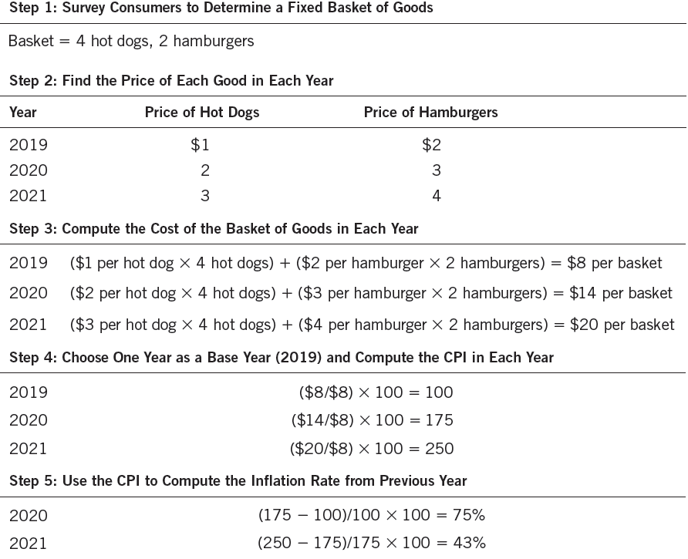
CONSUMER PRICE INDEX: calculation

Slide 4
CONSUMER PRICE INDEX: problems in measurement
Substitution bias
Change in prices over the years is not proportionate
Consumers substitute goods and services for less expensive ones
Fixed basket of goods overestimates the change in prices
Introduction of new goods
More variety available for the consumer
Basket keeps changing
Unmeasured quality change
With declining quality of goods and unchanged prices, value of each unit of currency falls
Increased quality with unchanged prices, value of each unit of currency increases
Inflation is officially stated with a 0.5 to 1 percent bias

Slide 5
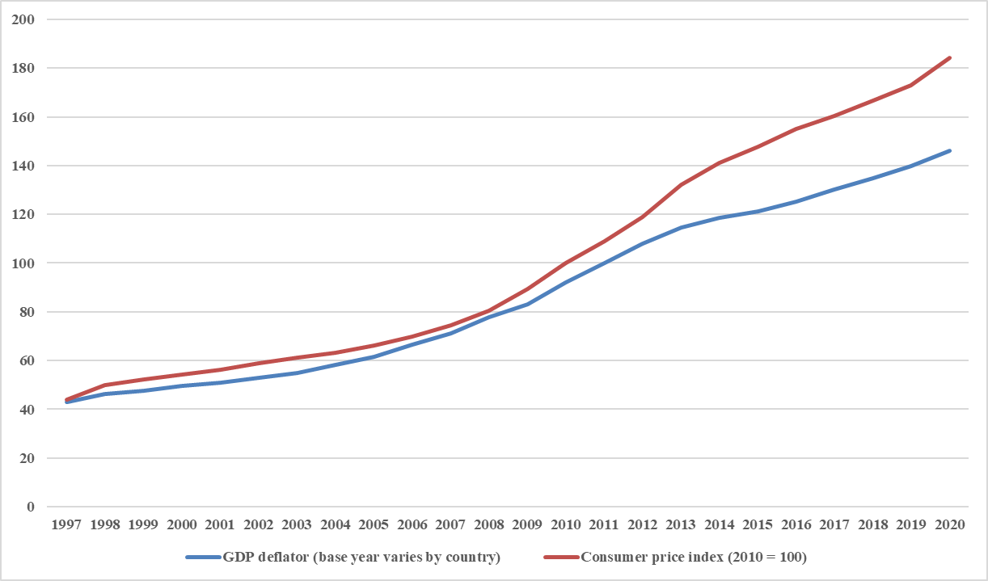
CONSUMER PRICE INDEX: v/s GDP deflator
Domestic prices versus consumer prices
GDP deflator represents price level of goods and services produced domestically
CPI represents price level of goods and services bought by consumers
Changing basket versus fixed basket of goods
GDP accounts for changes in the goods and services produced
CPI accounts for a fixed basket of goods only

Slide 6
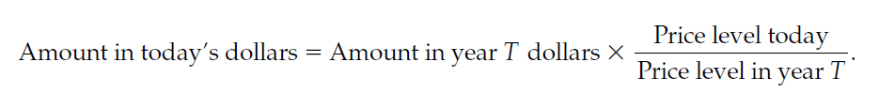
CORRECTING FOR INFLATION
Accounting for the value of money over time
Widely applicable in many macroeconomic contexts
Method of indexation
By law or legally binding contract, the money value of certain variables is automatically corrected to take into account inflation
Eg: Increase in dearness allowance
Real versus nominal interest rates
Nominal interest rate: the interest rate as usually reported without correction for the effects of inflation
Real interest rate the interest rate corrected for the effects of inflation
$$Real interest rate =Nominal interest rate −rate of inflation$$

